Slide 1

IBM HR Analytics Employee Attrition & performance (EDA Project)
Hussain Al-Sultan

Slide 2

Work Progress
Step 1
Data Exploring and cleaning
Step 2
Fix and remove any noisy rows
This Photo by Unknown Author is licensed under CC BY-SA
Step 3
Step 4
Answering the questions
Problem solution and recommendation
PHASE 5
Find top/bottom five stations

Slide 3
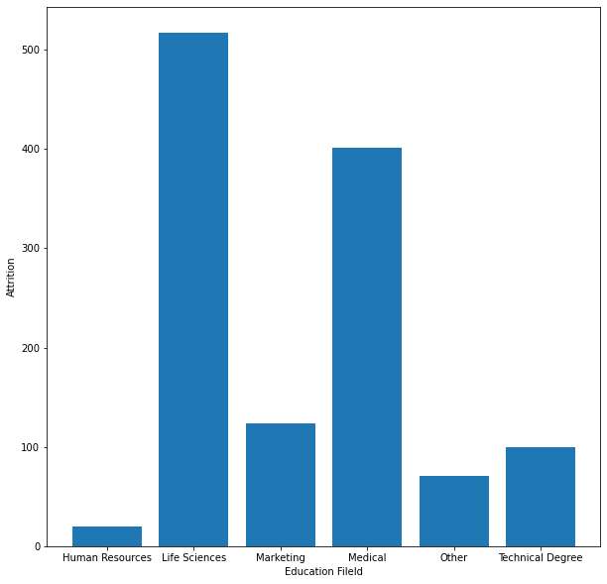
Q1)What is the most impacted field of education by attrition?

Slide 4
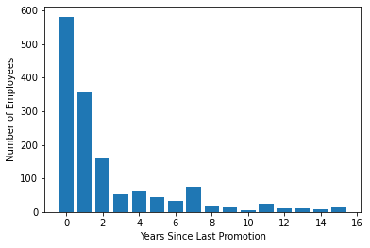
Q2) What is the consequence of last promotion on the number of attritions?

Slide 5
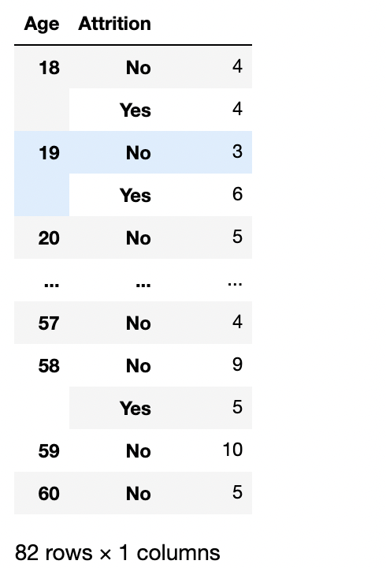
Q3)What is the relationship between the age and attrition?

Slide 6
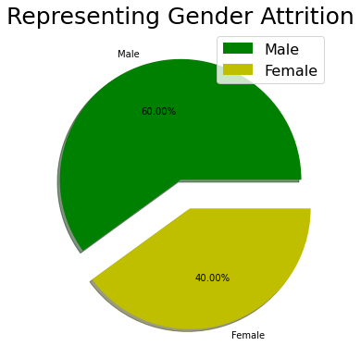
Q4) What is the relationship between gender and attrition?

Slide 7
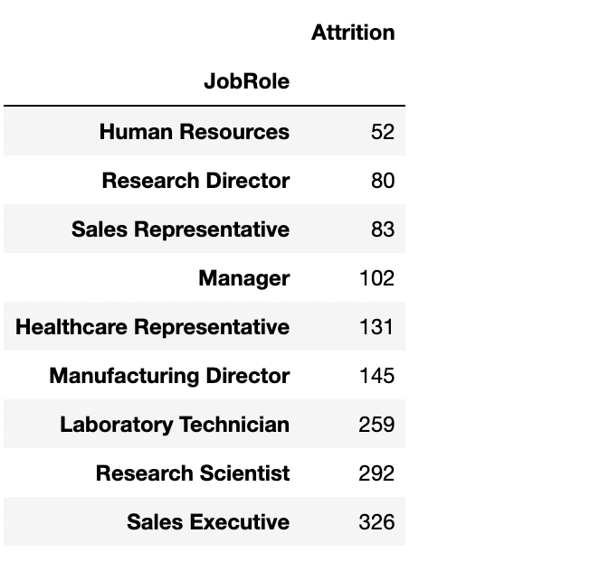
Q5) How job role in the company effect attrition?

Slide 8
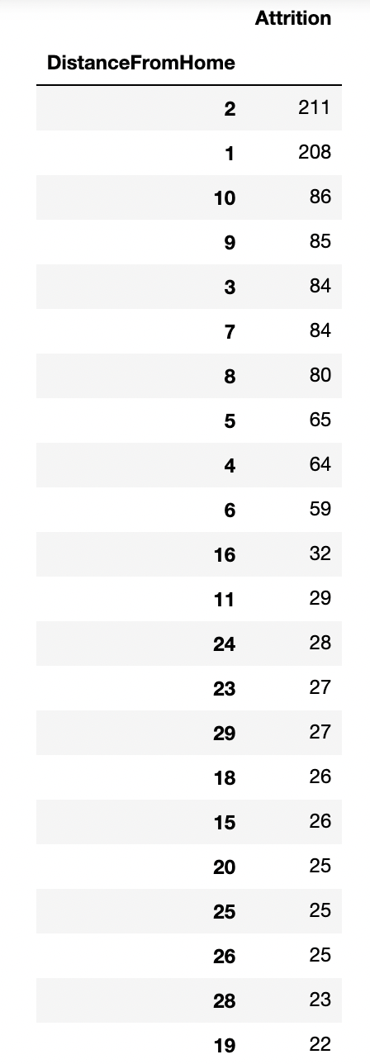
Q6) How distance from home effect attrition?

Slide 9
Conclusion

